Slide 1
WELCOME TO
ST. ANDREW’S COLLEGE OF ARTS, SCIENCE AND COMMERCE, BANDRA(W), MUMBAI-50
St Andrew's College of Arts, Science and Commerce Orientation 2024-2025

Slide 2
ORIENTATION
2024-2025
St Andrew's College of Arts, Science and Commerce Orientation 2024-2025

Slide 3
COLLEGE CREST AND MOTTO
St Andrew's College of Arts, Science, and Commerce Orientation 2024-2025

Slide 4
COLLEGE VISION
A commitment to guide our students to achieve excellence through holistic education
St Andrew's College of Arts, Science and Commerce
Orientation 2024-2025

Slide 5
COLLEGE
MISSION
To mould students to be morally upright, socially committed and spiritually inspired, by Christian principles, to be responsible citizens of India and the world.
To enable students realise their full potential in academic, cultural and sporting pursuits.
To foster a scientific temper and encourage students to adopt a rational approach to solve problems.
St Andrew's College of Arts, Science and Commerce Orientation 2024-2025

Slide 6
COLLEGE
MISSION
To empower students to be good leaders who will spread the light of knowledge, harmony and equality in all spheres of life.
To equip students with the required knowledge and skills to face the challenges of the real world
St Andrew's College of Arts, Science , and Commerce Orientation 2024-2025

Slide 7
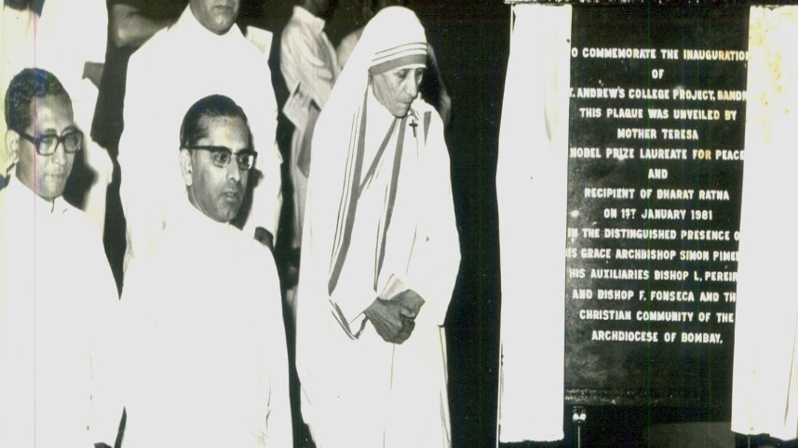
BLESSED BEGINNINGS-
1 JANUARY 1981
NOBEL LAUREATE MOTHER TERESA UNVEILS THE PLAQUE
St Andrew's College of Arts, Science and Commerce
Orientation 2024-2025

Slide 8
BLESSED BEGINNINGS-
5 MARCH 1984
SETTING A FIRM FOUNDATION -
Simon Cardinal Pimenta and Msgr. Nereus Rodrigues
St Andrew's College of Arts, Science and Commerce Orientation 2024-2025

Slide 9
WE HAVE GROWN.. FLOOR BY FLOOR,
BUILDING BY BUILDING
1 JUNE 1986
Completion of 18 classrooms ground plus two floors
Third Floor 1999-2000
Fourth Floor 2003-2004
St Andrew's College of Arts, Science and Commerce
Orientation 2024-2025

Slide 11
OUR MANAGEMENT
Advocate Joaquim Reis
Trustee
Rev. Fr. Aniceto Pereira
Trustee (Acting Rector)
CHAIRMAN OF BOARD OF TRUSTEES
His Eminence Oswald Cardinal Gracias
Rev. Fr. Clarence Fonseca
Managing Trustee
St Andrew's College of Arts, Science, and Commerce Orientation 2024-2025

Slide 12
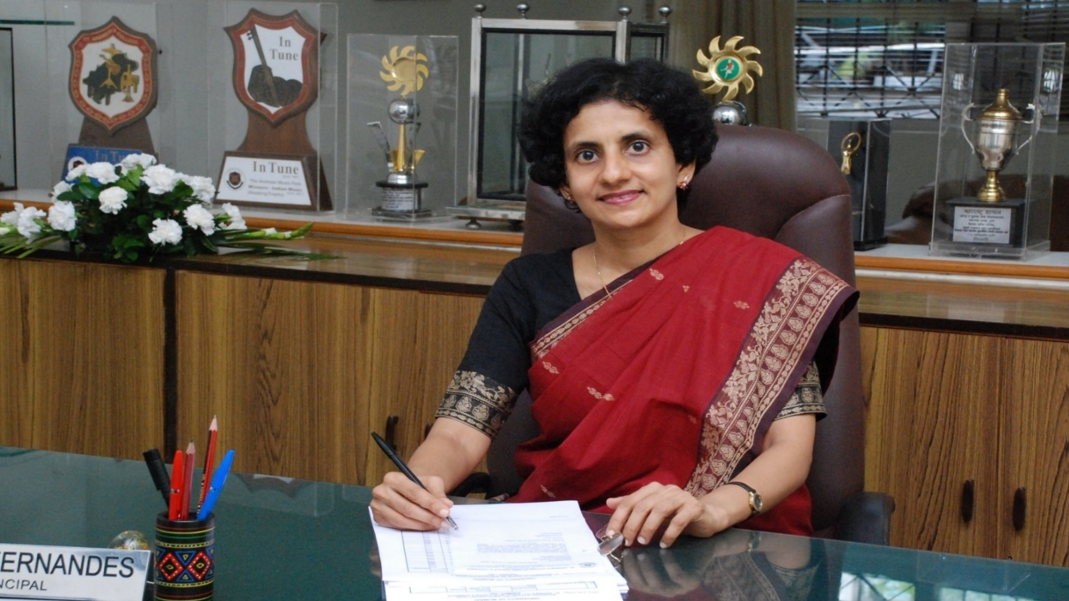
OUR PRINCIPAL
PROF. (DR). MARIE B. FERNANDES
St Andrew's College of Arts, Science , and Commerce Orientation 2023-2024

Slide 13
OUR VICE PRINCIPALS
DR. SHARON GOSALVES-DURHAM
VICE PRINCIPAL-SFC
DR. SUSAN LOBO
VICE PRINCIPAL- AIDED SECTION
St. Andrew's College of Arts, Science, and Commerce Orientation 2024-2025

Slide 15
RECOGNITION
In the fourth cycle of NAAC accreditation,
St. Andrew's College was awarded 3.35 CGPA A+
St Andrew's College of Arts, Science, and Commerce
Orientation 2024-2025

Slide 17
DISTINCTIVE FEATURES OF NEP
Multidisciplinary
4 years Honours and Honours with Research Degree
22 Credits per semester
Multiple Entry and Exit
Credits for all student activities:-curricular, extra-curricular and co-curricular
Students can earn credits from multiple institutions to aid navigation across institutions through adoption of ACADEMIC BANK OF CREDITS
Vocational and Skill Courses now integrated into the main stream:- Skill enhancement through VSEC is related to the Major subject
Opening of Indian Knowledge System (IKS) Courses- a defining feature of NEP 2020
Inclusion of Value-based dimension:-Universal human values for global citizenship.
Promotion of Indian Languages:-Communication skills in English for personal growth, learning cultural moorings of our country, study materials in local languages
St. Andrew's College of Arts, Science, and Commerce Orientation 2024-2025

Slide 18
DISTINCTIVE FEATURES OF NEP
Multidisciplinary
4 years Honours and Honours with Research Degree
22 Credits per semester
Multiple Entry and Exit
Credits for all student activities:-curricular, extra-curricular and co-curricular
Students can earn credits from multiple institutions to aid navigation across institutions through adoption of ACADEMIC BANK OF CREDITS
Vocational and Skill Courses now integrated into the main stream:- Skill enhancement through VSEC is related to the Major subject
Opening of Indian Knowledge System (IKS) Courses- a defining feature of NEP 2020
Inclusion of Value-based dimension:-Universal human values for global citizenship.
Promotion of Indian Languages:-Communication skills in English for personal growth, learning cultural moorings of our country, study materials in local languages
St. Andrew's College of Arts, Science, and Commerce Orientation 2024-2025

Slide 19
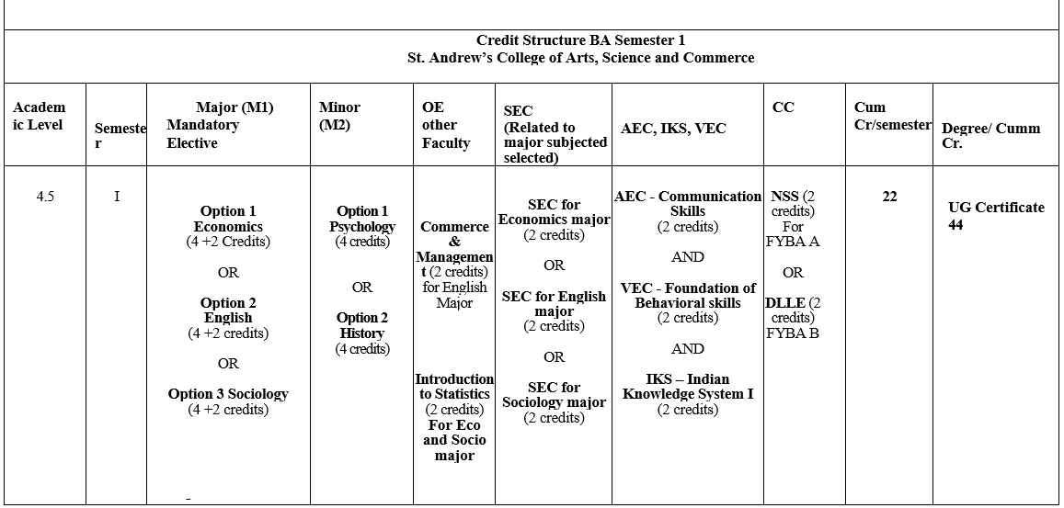
NEP STRUCTURE FOR F.Y. B.A

Slide 20
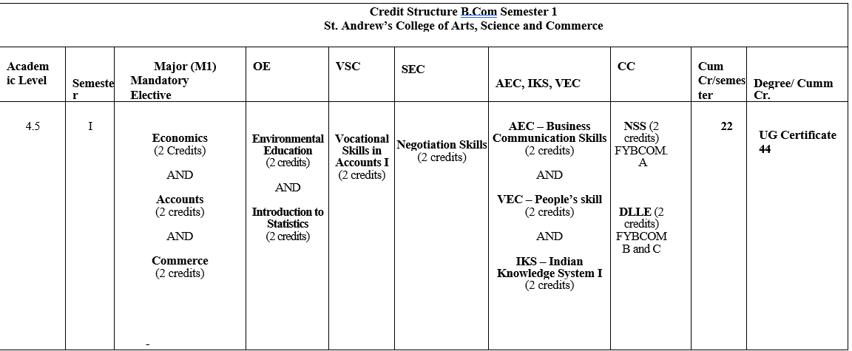
NEP STRUCTURE FOR F.Y. B.Com

Slide 21
LET’S LEARN MORE: CERTIFIED COURSES
1. Adv Excel with PowerBI & AI Tools
2. ⁠Advance GST Accounting with Tally Prime
3. ⁠Digital Marketing with Social Media Marketing
4. Personal Financial Planning & Wealth Management
5. Design Thinking
6. AI Tools and Its Use Cases
7. Social Media Marketing
8. Ethical Hacking & Cybersecurity
9. Fintech and BlockChain
10. Instructional Design & Learning and Development Expert
11. HR Operations with Power Business Intelligence (BI)
12. Introduction to French Language and Business Communication
13. Business Analytics for Finance and Marketing
St. Andrew's College of Arts, Science, and Commerce Orientation 2024-2025

Slide 22
SCHOLARSHIPS FOR BRILLIANT STUDENTS
The Grenville & Vinita Solomon Academic Scholarship (2022-23)
Prof. Maewest Dias Endowment Scholarship (2022-23)
GET AWARDED
FOR STUDYING
GOVERNMENT
Minority Scholarship
COLLEGE SCHOLARSHIPS DEGREE
Scholarships, Prizes, Freeships
FOR DETAILS VISIT THE
COLLEGE WEBSITE AND PROSPECTUS
St Andrew's College of Arts, Science, and Commerce
Orientation 2024-2025

Slide 23
MENTORING
FOR DETAILS CONTACT YOUR CLASS TEACHER
St Andrew's College of Arts, Science, and Commerce
Orientation 2024-2025

Slide 24
INFRASTRUCTURE
Our classrooms are equipped with white boards and overhead projection facilities
St Andrew's College of Arts, Science, and Commerce
Orientation 2024-2025

Slide 25
INFRASTRUCTURE
Electronics Laboratory
Computer Laboratories
St Andrew's College of Arts, Science, and Commerce Orientation 2024-2025

Slide 26
AV ROOM
St Andrew's College of Arts, Science, and Commerce
Orientation 2024-2025

Slide 27
LIBRARY
Timings :
7.30 a.m. to 5.00 p.m.
Monday to Saturday
St Andrew's College of Arts, Science, and Commerce Orientation 2024-2025

Slide 28
LIBRARY
- Couch Corner
- Circulation Counter
St Andrew's College of Arts, Commerce and Science Orientation 2023-2024

Slide 29
LIBRARY
Language Lab
Multimedia Library
St Andrew's College of Arts, Commerce and Science Orientation 2023-2024

Slide 30
COMMON ROOMS
St Andrew's College of Arts, Science, and Commerce
Orientation 2024-2025

Slide 31
GYMKHANA
(Outdoor Sports)
St Andrew's College of Arts, Science, and Commerce Orientation 2024-2025

Slide 32
GYMNASIUM
St Andrew's College of Arts, Science, and Commerce
Orientation 2024-2025

Slide 33
AUDITORIUM

Slide 34
THE OFFICE
St Andrew's College of Arts, Science, and Commerce
Orientation 2024-2025

Slide 35
PHOTOCOPY COUNTER
St Andrew's College of Arts, Science, and Commerce
Orientation 2024-2025

Slide 36
STAFF
ROOMS
St Andrew's College of Arts, Science, and Commerce
Orientation 2024-2025

Slide 37
HD CCTV CAMERAS
St Andrew's College of Arts, Science, and Commerce
Orientation 2024-2025

Slide 38
CHAPEL
St Andrew's College of Arts, Science, and Commerce Orientation 2024-2025

Slide 39
UNIVERSITY OF MUMBAI Ordinance with effect from 2014-15
As per O.6086
Every bonafide learner shall be allowed to keep terms for the given semester in a programme of her/his enrolment,
only if s/he fulfills at least seventy five percent (75%) in EACH SUBJECT
ATTENDANCE
The Attendance Committee ensures that
Attendance records are maintained.
Warning letters are issued every semester
Attendance records are displayed on the college notice board and college website
St Andrew's College of Arts, Science, and Commerce
Orientation 2024-2025

Slide 40
The defaulting student and parent/guardian will be called.
Consequences will be made clear and the student will be encouraged to comply with the requirement of the attendance.
At the end of the semester, the list of students who are not allowed to keep terms will be displayed.
In-Charge of Examinations / the Controller of Examinations will be intimated to withdraw the examination forms of such defaulters.
ATTENDANCE
DEFAULTERS
St Andrew's College of Arts, Science, and Commerce
Orientation 2024-2025

Slide 41
10 DAYS BEFORE
THE COMMENCEMENT OF
THE SEMESTER END EXAMINATION
DEFAULTING LEARNERS
WILL BE INTIMATED THAT
THEIR EXAMINATION FORMS
HAVE BEEN WITHDRAWN
ATTENDANCE
DEFAULTERS
St Andrew's College of Arts, Science, and Commerce
Orientation 2024-2025

Slide 42
SEMESTER END EXAMINATIONS AND
A.T.K.T. EXAMINATIONS WILL BE CONDUCTED
AS PER INSTRUCTIONS OF THE UNIVERSITY OF MUMBAI.
THE TIMETABLE WILL BE DISPLAYED AS PER INSTRUCTIONS OF THE UNIVERSITY OF MUMBAI.
KEEP IN TOUCH WITH THE COLLEGE WEBSITE AT ALL TIMES
SCHEDULE OF EXAMINATIONS
St Andrew's College of Arts, Science, and Commerce
Orientation 2024-2025

Slide 43
Make sure that there are no books, bits of paper, etc., in your possession or on your desk or in the vicinity of your desk.
Make sure that your mobiles are not with you in the examination hall.
Do not speak or communicate in any manner with any other candidate during the examination.
Do not exchange writing materials, calculators etc. with neighbouring candidates.
Before the commencement of an examination, students must
St Andrew's College of Arts, Science, and Commerce
Orientation 2024-2025

Slide 44
Students caught trying to copy or found copying during the examinations will be dealt with as per Ordinance No. 5050 (University of Mumbai) by the Unfair Means Committee.
A student found guilty of using unfair means will lose a full academic year.
UNFAIR MEANS
St Andrew's College of Arts, Science, and Commerce
Orientation 2024-2025

Slide 45
GRADES | MARKS | PERFORMANCE
O | 80 and above | Outstanding
A+ | 70 to 79.99 | Excellent
A | 60 to 69.99 | Very Good
RESULTS
INTERPRETATION OF GRADES FOR COURSES
St Andrew's College of Arts, Science, and Commerce
Orientation 2024-2025

Slide 46
B+ | 55 to 59.99 | Good
B | 50 to 54.99 | Above Average
C | 45 to 45.99 | Average
D | 40 to 44.99 | Pass
F | Less than 40 | Fail
RESULTS
INTERPRETATION OF GRADES FOR COURSES
St Andrew's College of Arts, Science, and Commerce
Orientation 2024-2025

Slide 47
SGPA | GRADE
10 | O
9-9.99 | A+
8-8.99 | A
7-7.99 | B+
6-6.99 | B
5-5.99 | C
4-4.99 | D
RESULTS-
INTERPRETATION OF OVERALL GRADE TABLE
SGPA
The final grade earned by a learner at the end of three years in college is a cumulative grade point average of all
six Semester Grade Point Averages (SGPAs).
St Andrew's College of Arts, Science, and Commerce
Orientation 2024-2025

Slide 48
Verification : Students can request the office to check the marks
Photocopy : Students can ask for a copy of the assessed answer booklet
Revaluation : Can be requested before or after asking for a photocopy if the student feels s/he deserved more marks
***Applications must be submitted to the office within 7 days
of declaration of results
RESULTS- VERIFICATION, PHOTOCOPY, REVALUATUON
St Andrew's College of Arts, Science, and Commerce
Orientation 2024-2025

Slide 49
With effect from 2015-16
All semester internal assessment and semester end examinations are conducted in every Semester.
Thus if a student fails in some/all papers in Semester I /III s/he can appear for these papers when the Semester II/ IV exams are conducted.
Similarly, if a student fails in Semester II /IV examinations s/he can appear for these papers in the following Semester.
WHEN ARE A.T.K.T. EXAMINATIONS CONDUCTED ?
St Andrew's College of Arts, Science, and Commerce
Orientation 2024-2025

Slide 50
Students should keep in touch with the college notice boards and website for exam related information.
Students should report to the examination hall on time.
Students must carry their identity card and hall ticket.
Students must collect their hall ticket and results from the office on the date and time specified.
St Andrew's College of Arts, Science, and Commerce Orientation 2024-2025

Slide 51
•Inform the office one week in advance of exams if you need concession as an LD /physically challenged student.
•DO NOT INDULGE IN UNFAIR PRACTICES DURING EXAMINATIONS
•Follow notifications on the college website at all times
St Andrew's College of Arts, Science, and Commerce Orientation 2024-2025

Slide 52
Minimum 75 % attendance in all subjects in all semesters.
A good academic record in all six semesters.
Good conduct.
Active participation in co-curricular and extra-curricular activities conducted by the college, especially those that are relevant to the course or job you are applying for.
Completion of at least two courses during your years of study in this institution. The courses could be -
Certificate Courses conducted by the college
OR
Courses conducted by portals such as MOOC, Coursera, or Swayam
LETTER OF RECOMMENDATION ELIGIBILTY CRITERIA:
ALL OF THE FOLLOWING ARE NECESSARY
St Andrew's College of Arts, Science, and Commerce
Orientation 2024-2025

Slide 53
TRAINING & PLACEMENT CELL
The Training and Placement Cell seeks to provide a platform for students to find the right job.
For more details visit the college website:
https://placementcell2.wixsite.com/standrewscollege
St Andrew's College of Arts, Science, and Commerce Orientation 2024-2025

Slide 54
SPECIAL CELLS:
ANTI- RAGGING CELL
To ensure zero ragging on campus,
our college abides by rules and regulations as per Section 6.2 of Mumbai University.
St Andrew's College of Arts, Science, and Commerce
Orientation 2024-2025

Slide 55
University Women Development Cell set up in response to the Vishaka judgment passed by the Supreme Court in 1997
OBJECTIVES:
-- To sensitise students to the issues related to gender with specific reference to sexual harassment at the work place and its legal implications
-- To promote the well being of all female students and staff members and create a gender sensitised community on campus.
-- To form an Internal Complaints Committee (ICC) to scrutinise complaints received.
COLLEGE
WOMEN
DEVELOPMENT
CELL
St Andrew's College of Arts, Science, and Commerce Orientation 2024-2025

Slide 56
This includes eve teasing,
verbal harassment (in the form of comments, jokes, text messages etc) of a sexual nature.
Unwanted touching or physical contact.
Cyber bullying ( text message, emails, photos which are sexual in nature, showing pornographic films)
SEXUAL HARASSMENT COMPLAINTS WILL BE DEALT BY THE ICC (INTERNAL COMPLIANTS COMMITTEE)
Complaints can be reported orally or in writing to the concerned class teacher, and will then be forwarded to the Internal Complaints Committee.
.
Serious offences will be registered as Police complaints
St Andrew's College of Arts, Science, and Commerce Orientation 2024-2025

Slide 57
STANDING COMMITTEE ON RESERVATIONS
St. Andrew’s College has
a portal for reporting complaints on caste based discrimination to prevent discrimination on the basis of caste.
St Andrew's College of Arts, Science, and Commerce Orientation 2024-2025

Slide 58
Total Collection : 46500+
Reference books, text books and rare books
Journals 24
Subject specific research type information
Magazines 17
For general information
English newspapers 05
For current information of daily happenings
E-Resources - CD & VCD (movies, play)
N-list Database for E-journals, E-books & E-database
RESOURCES OF THE LIBRARY
St Andrew's College of Arts, Science, and Commerce Orientation 2024-2025

Slide 59
Students have a special Orientation by the Librarian for all matters related to the library including the following:
ACCESS TO THE ONLINE LIBRARY CATALOGUE TO KNOW YOUR LIBRARY COLLECTION
INSTITUTIONAL REPOSITORY
MOODLE -
QUESTION PAPER REPOSITORY & SYLLABUS
USEFUL LINKS
LIBRARY SERVICES
LIBRARY SERVICES
St Andrew's College of Arts, Science, and Commerce Orientation 2024-2025

Slide 60
LIBRARY BEST USER AWARD
Library Best User Award
for students based on library performance.
St Andrew's College of Arts, Science, and Commerce Orientation 2024-2025

Slide 61
Use of cell phones is strictly prohibited in the library
Absolute silence is required in the library.
Eatables are not allowed inside the library
Exchange of I-Card or Library card is not allowed.
If any book is lost the borrower is liable to replace it.
A late fee of Rs.1 per day per book shall be charged for those who fail to return the book on the due date.
Reading material like reference books / question papers / newspapers / syllabus etc issued on the Reading Room card should be returned on the same day.
THINGS TO REMEMBER IN THE LIBRARY
St Andrew's College of Arts, Science, and Commerce Orientation 2024-2025

Slide 62
CO - CURRICULAR AND EXTRA CURRICULAR ACTIVITIES
St Andrew's College of Arts, Science, and Commerce
Orientation 2024-2025

Slide 63
EVERY DEPARTMENT HAS AN ASSOCIATION THAT ORGANISES ACTIVITIES THROUGHOUT THE ACADEMIC YEAR….
1. English Association
2. Commerce Circle
3. Sociology Association
4. Economics Association
5. Psychology Team
6. History Association
7. Accountancy Association
St Andrew's College of Arts, Science, and Commerce Orientation 2024-2025

Slide 64
THE ANDREAN STUDENTS' LEAGUE
The ASL is the Students’ Council of St. Andrew’s College.
The motto of the ASL - ‘To Lead, To Serve’.
St Andrew's College of Arts, Science, and Commerce Orientation 2024-2025

Slide 65
CAMPUS COUNSELLOR
MS. KIMBERLY LOBO
AVAILABLE ON THE 4TH FLOOR
MONDAY AND FRIDAY
9 AM - 3 PM
St Andrew's College of Arts, Science, and Commerce Orientation 2024-2025

Slide 66
DRESS CODE
Students are required to follow the College Dress Code at all times.
Disciplinary action will be taken against students who do not follow the dress code.
St Andrew's College of Arts, Science, and Commerce Orientation 2024-2025

Slide 67
Keep the campus college clean
Switch off the lights and fans when not in use
St Andrew's College of Arts, Science, and Commerce
Orientation 2024-2025

Slide 69
...and as we conclude,
its not all work and no play at
St. Andrew’s!
We encourage our students to hone their skills, co-curricular and extra-curricular talents with the many events and celebratory days organised.
St Andrew's College of Arts, Science, and Commerce Orientation 2024-2025

Slide 70
This presentation was prepared by
Dr. Kashmira Mody (Department of Economics)
Dr. Susan Lobo (Department of English)
Naomi Rebello (TYBA)
Joanna Fernandes (TYBA)
Joiya Saamya (TYBA)
St Andrew's College of Arts, Science, and Commerce Orientation 2024-2025

Slide 71
St Andrew's College of Arts, Science, and Orientation 2024-2025

