Slide 1
Social Outreach Program
Review

Slide 2
Background
St. Andrew’s College approached CSA for an SOP for their 2nd-year students
Students had to complete 20 hours under this SOP
To be held Offline
Every student had to participate
Reports to be submitted towards the end

Slide 3
Preparation
CSA team prepared an outline of the program.
Identified groups across the DI and Mumbai.
Divided students into groups of five each.
Had meetings with the staff of the participating centres, informing them of the process and blocking time.
Assigned these intervention groups to student groups depending on the location of the students tp the best extent possible.

Slide 4
Preparation
Prepared activities for each of the intervention groups
Assigned mentors from CSA for each of the student groups
Prepared google forms for students to input their activities so that they can be tracked
Kept attendance sheets at the centres for physical verification of the activities on ground

Slide 5
Plan of Action
Break-up of the 20 hours
Group type specific Orientation – 2 hours
Meet and Greet – 2 hours
Other Activities – 12 hours
Interaction, Feedback and Learnings – 2 hours
Report and Documentation – 2 hours

Slide 6
Statistics
Intervention and student groups
Group Type | No. of Student Groups
Bal Sabha | 5
Domestic Workers | 1
English Language Class | 3
Financial Empowerment Program | 4
Kishori | 4
Self Help Groups | 16
Supplementary Classes | 15
Transgenders | 4

Slide 7
Statistics
Period: 08-11-22 to 23-03-23 – 136 days
Number of students: 258
Groups made: 52
Total Number of hours: 4,013
Average hours put in/student: ~16.5 hours

Slide 8
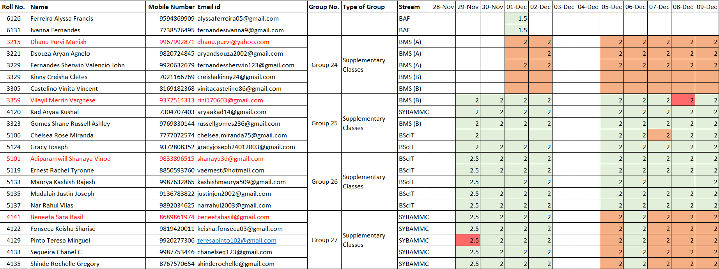
Trackers
Hours Tracker

Slide 9
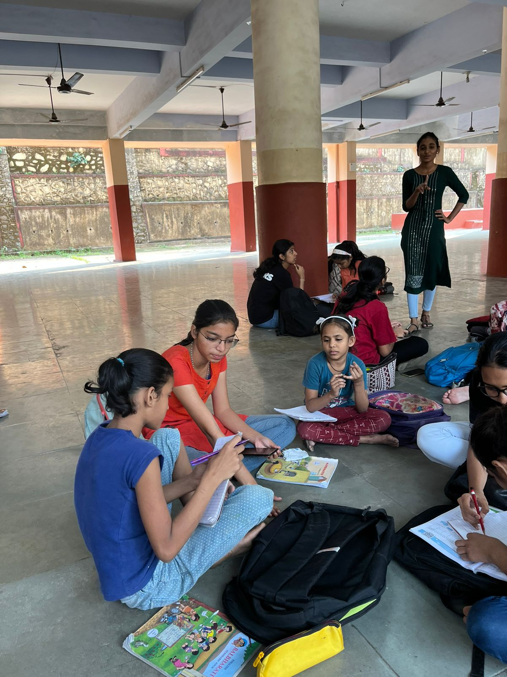
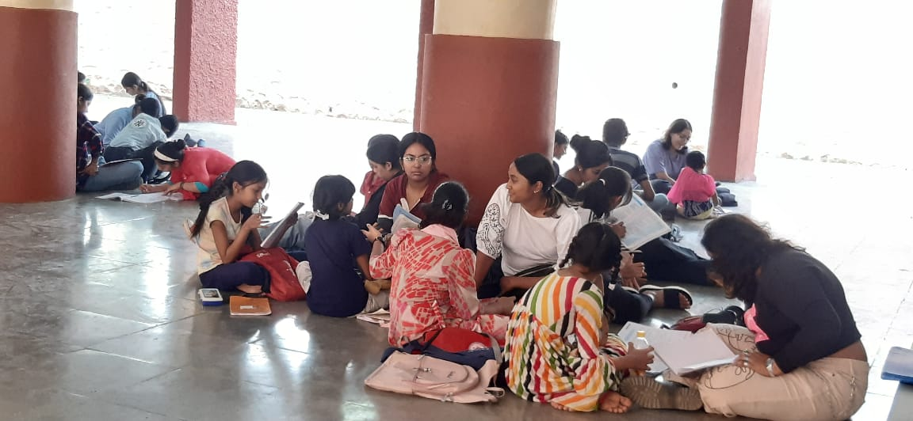
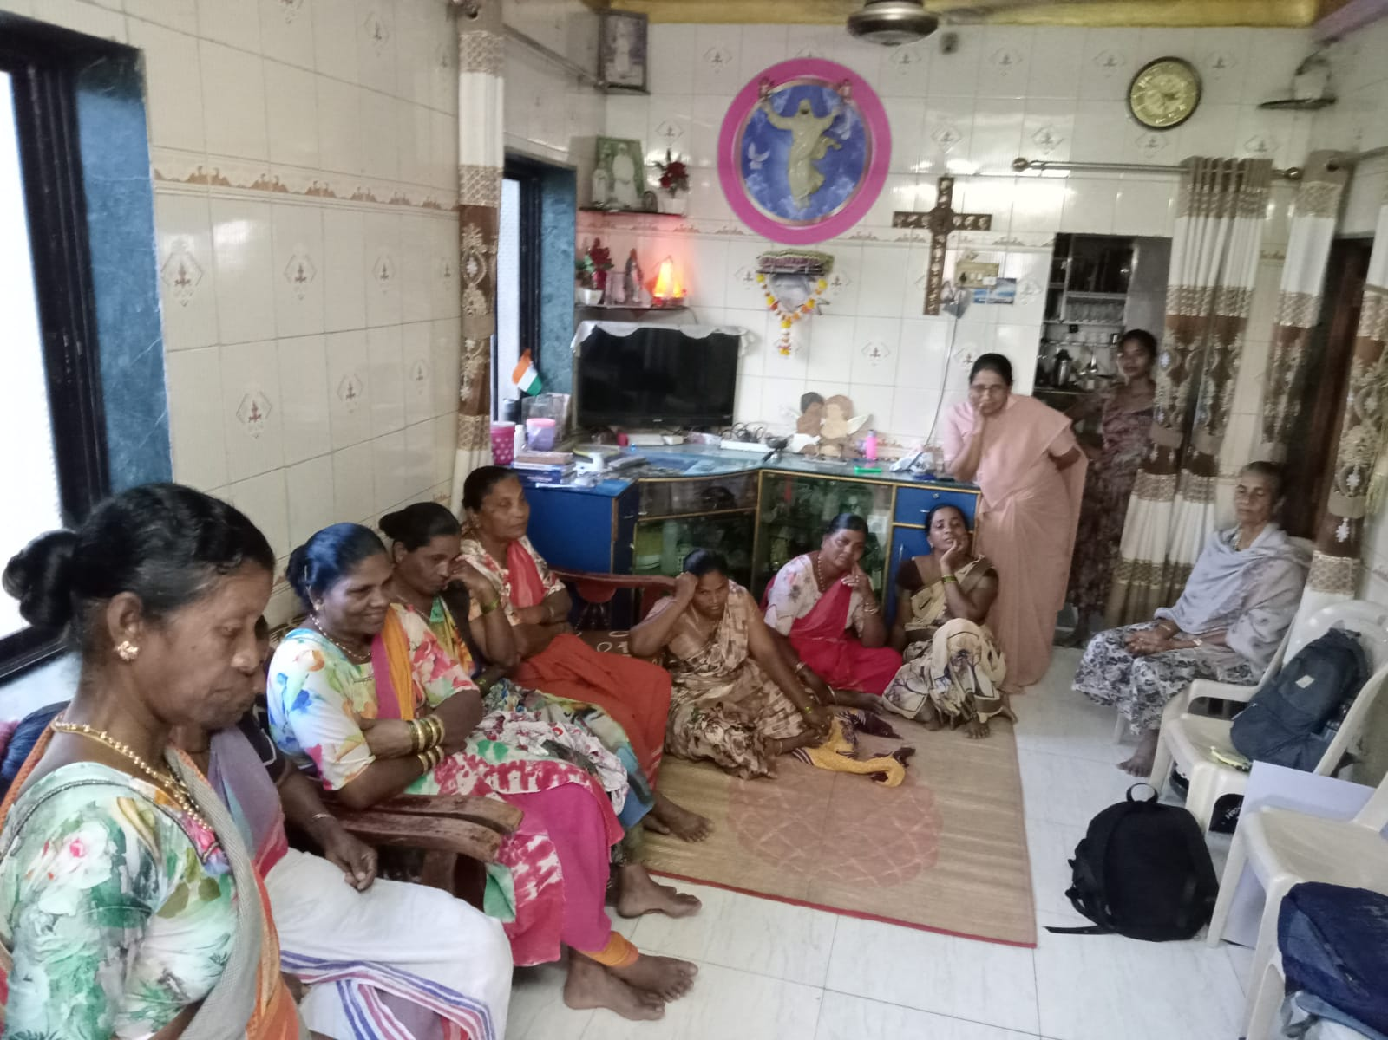

Slide 10
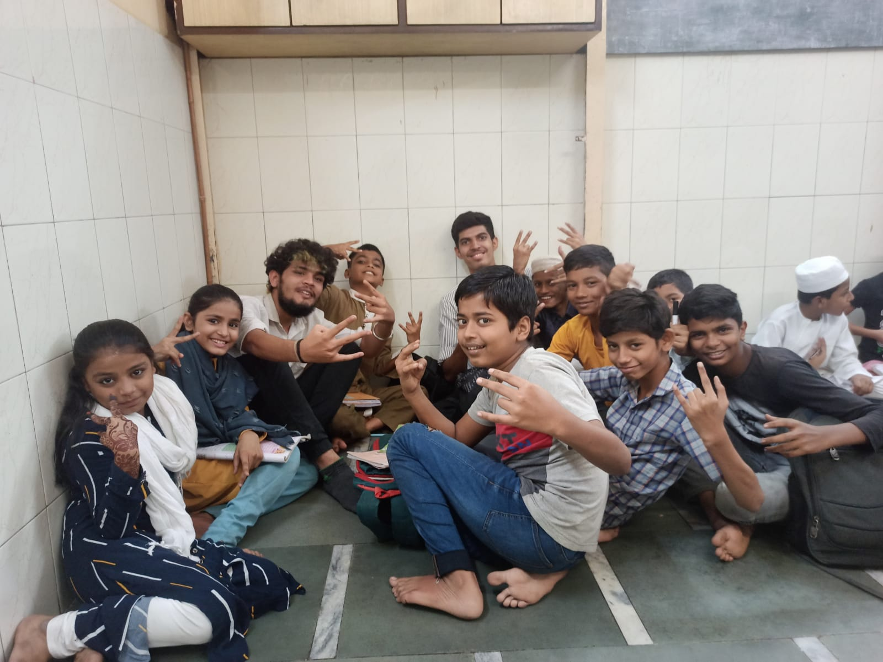
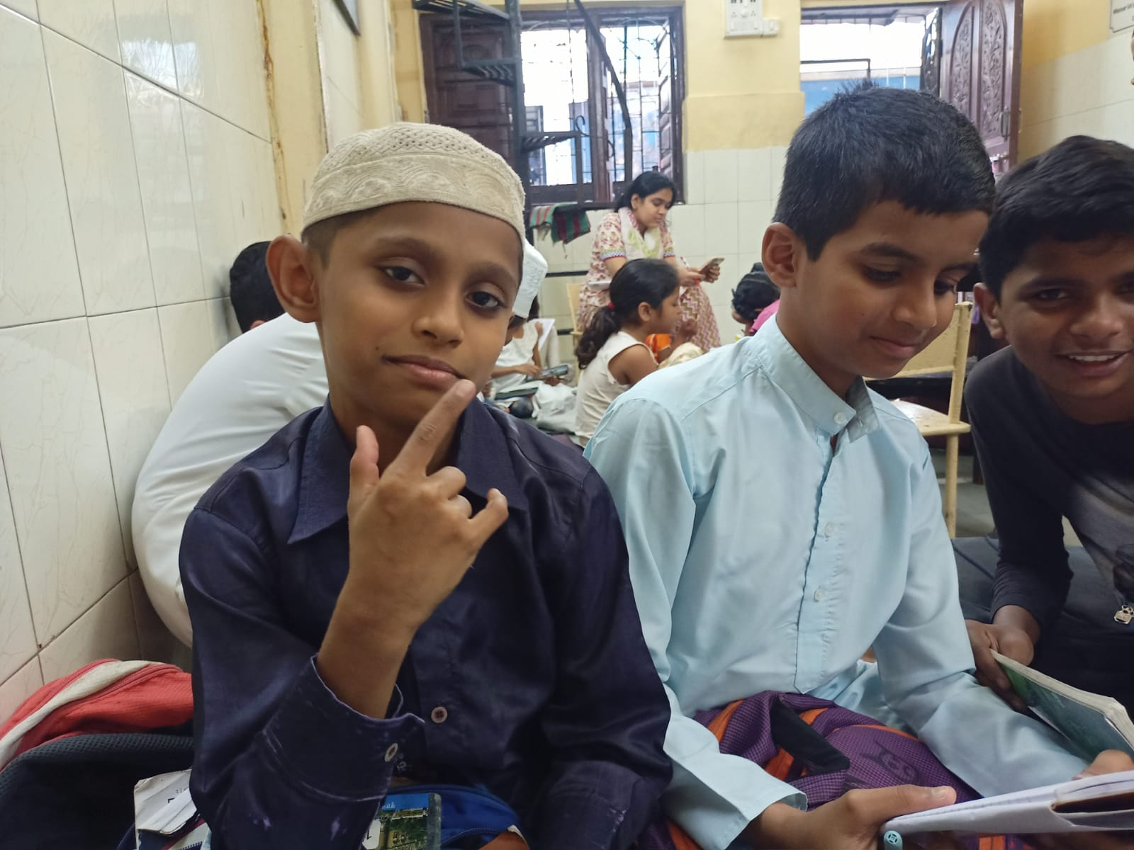
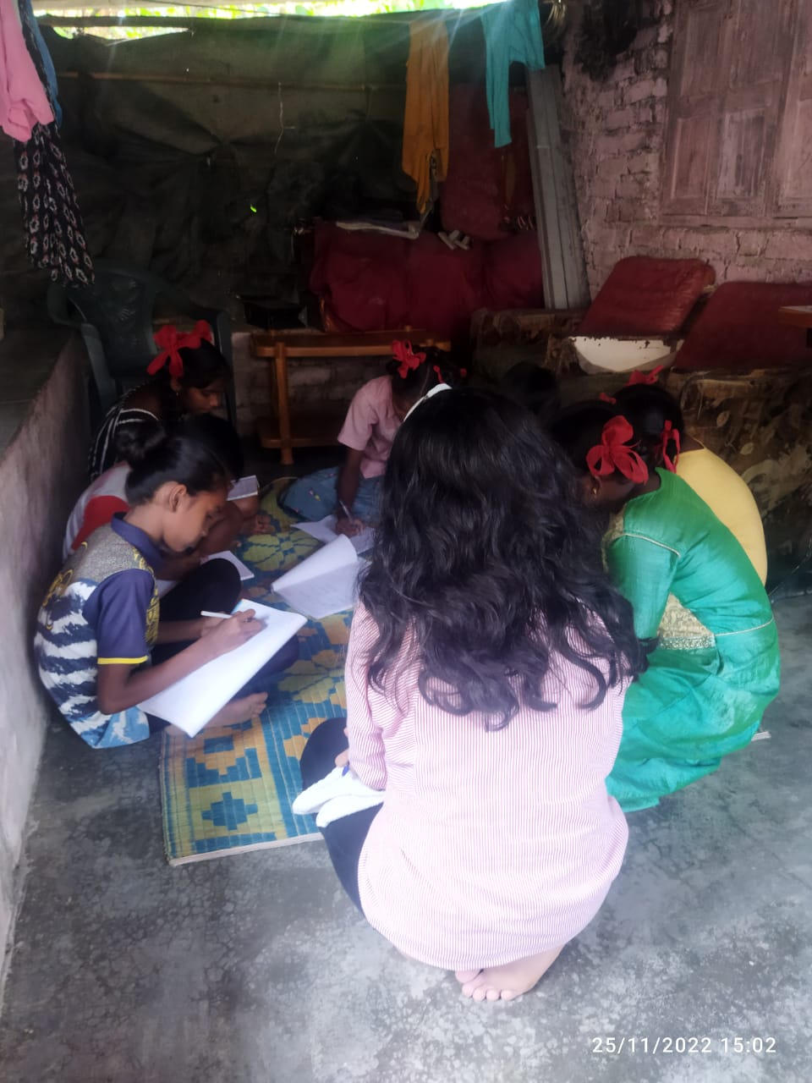
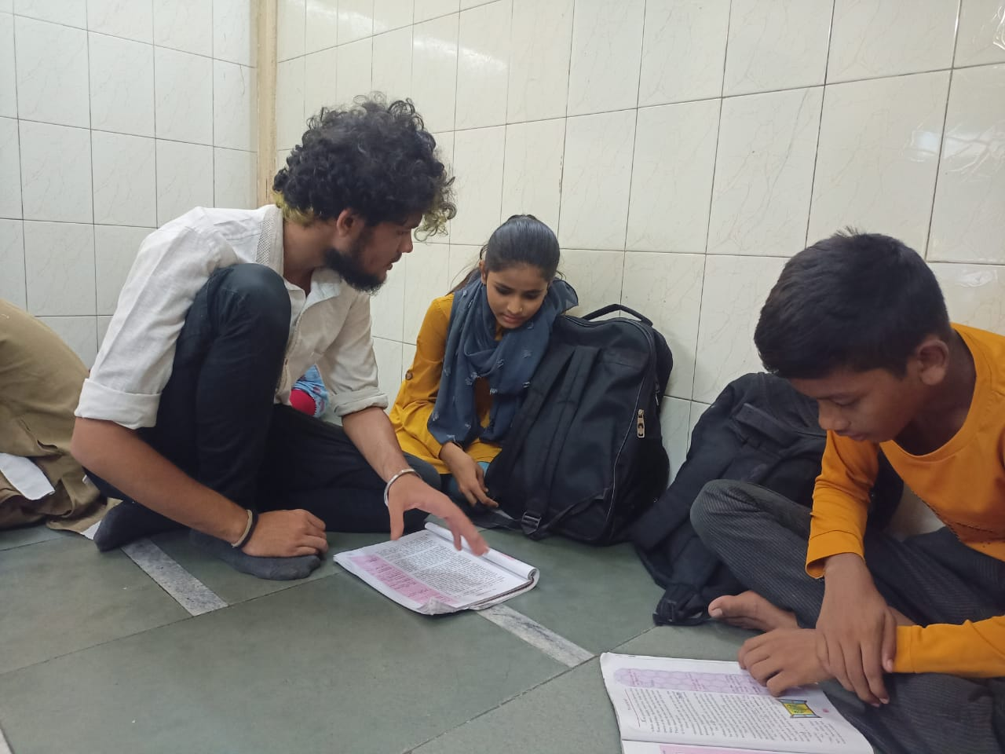

Slide 11
