Slide 1
Social Outreach Program
Review | 19-05-21

Slide 2
Background
St. Andrew’s College approached CSA for a SOP for their 2nd year students
Students had to complete 20 hours under this SOP
To be held online
Every student had to participate
Reports to be submitted towards the end

Slide 3
Preparation
CSA team prepared an outline of the program
Identified groups across the DI, Raigad and Mumbai which had network connectivity
Divided students into groups of five each
Had meetings with the staff of the participating centres, informing them of the process and blocking time
Assigned these intervention groups to student groups

Slide 4
Preparation
Prepared activities for each of the intervention groups
Assigned mentors from CSA for each of the student groups
Prepared google forms for students to input their activities so that it can be tracked

Slide 5
Plan of Action
Break-up of the 20 hours
Group type specific Orientation – 2 hours
Needs assessment with CSA group – 2 hours
Preparing sessions for the group – 2 hours
Other Activities – 12 hours
Report and Documentation – 2 hours

Slide 6
Statistics
Number of intervention groups assigned:
Group Type | No. of Student Groups
Domestic Workers | 2
Bal Sabha | 19
Financial Empowerment Program | 5
English Language Class | 6
Digital Literacy | 2
Gavki | 1
Livelihood | 6
Farmers Group | 1
Self Help Groups | 24

Slide 7
Statistics
Period: 18-01-21 to 09-04-21 – 82 days
Number of students: 326
Groups made: 66
Total Number of hours: 6,176
Average hours put in/student: 18.9 hours

Slide 8
Statistics
Hours Completed | Count of Students
> 20 hours | 61
= 20 hours | 194
= 19 hours | 8
= 18 hours | 26
< 18 hours | 37

Slide 9
Statistics
Groups as a unit completing 20 hours
Group Type | No. of Student Groups | % age
Groups completed 20 hours | 26 | 39%
Groups not completing 20 hours | 40 | 61%
Total | 66

Slide 10
Statistics
Intervention-wise groups completing 20 hours
Group Type | No. of Student Groups | Completed 20 hours
Bal Sabha | 19 | 7
Financial Empowerment Program | 5 | 4
English Language Class | 6 | 1
Digital Literacy | 2 | 1
Livelihood | 6 | 2
Self Help Groups | 24 | 11

Slide 11
Statistics
Students completing 20 hours - Individually
Group Type | Students Assigned | Completed 20 hours | %age
Bal Sabha | 95 | 71 | 75%
Digital Literacy | 10 | 9 | 90%
Domestic Workers | 10 | 6 | 60%
English Language Class | 26 | 17 | 65%
Farmers Group | 5 | 4 | 80%
Financial Empowerment Program | 25 | 24 | 96%
Gavki | 5 | 4 | 80%
Livelihood | 30 | 24 | 80%
Self Help Groups | 120 | 96 | 80%
Total | 326 | 255 | 78%

Slide 12
Statistics

Slide 13
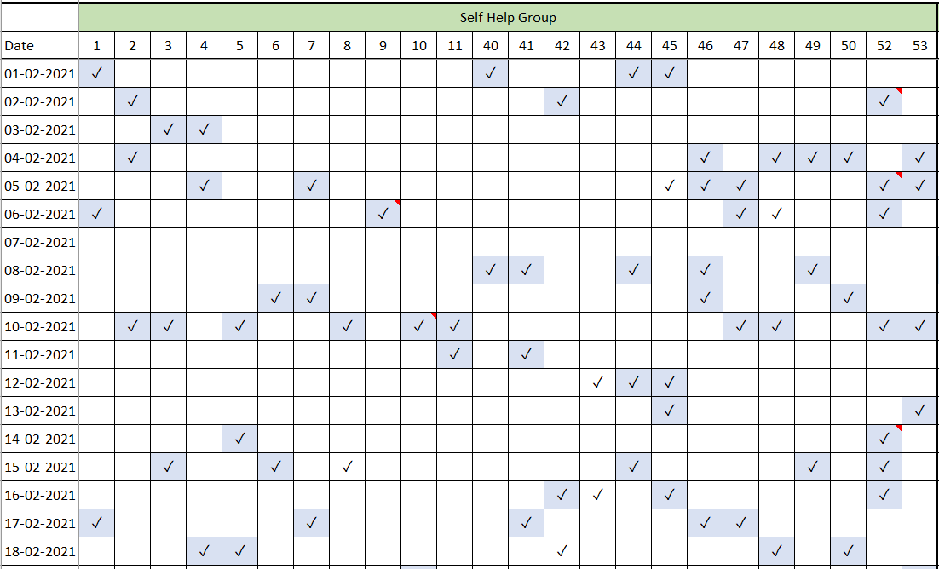
Trackers
Google Forms and Activity Tracker

Slide 14
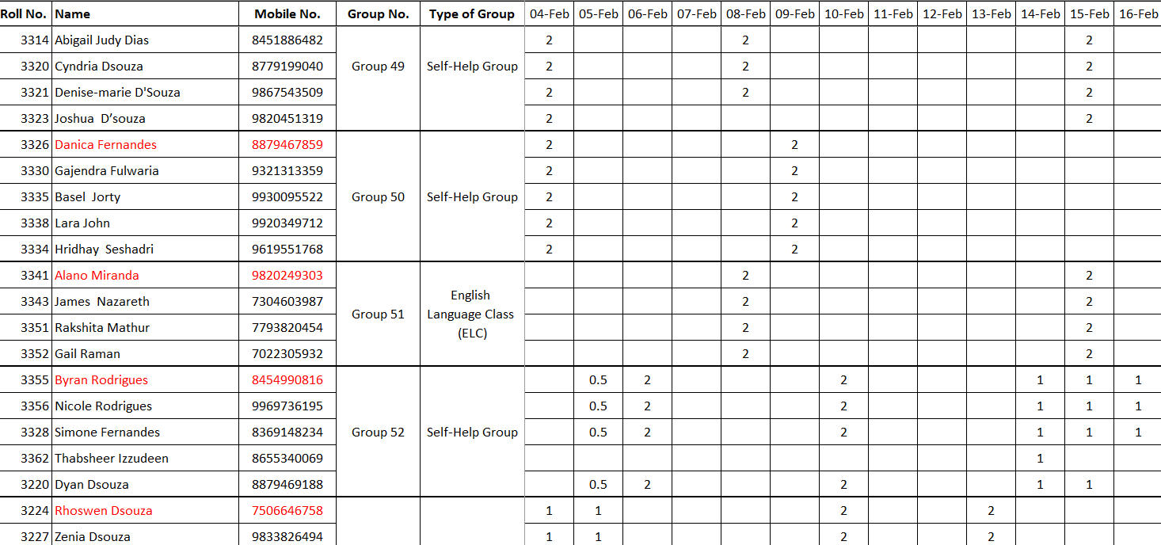
Trackers
Hours Tracker

