Slide 1
Social Outreach Program
Review

Slide 2
Background
St. Andrew’s College approached CSA for a SOP for their 2nd year students
Students had to complete 20 hours under this SOP
To be held online
Every student had to participate
Reports to be submitted towards the end

Slide 3
Preparation
CSA team prepared an outline of the program
Identified groups across the DI, Raigad and Mumbai which had network connectivity
Divided students into groups of five each
Had meetings with the staff of the participating centres, informing them of the process and blocking time
Assigned these intervention groups to student groups

Slide 4
Preparation
Prepared activities for each of the intervention groups
Assigned mentors from CSA for each of the student groups
Prepared google forms for students to input their activities so that it can be tracked

Slide 5
Plan of Action
Break-up of the 20 hours
Group type specific Orientation – 2 hours
Meet and Greet – 2 hours
Other Activities – 12 hours
Interaction, Feedback and Learnings – 2 hours
Report and Documentation – 2 hours
Three activities added as wild card, giving students 6 hours to cover deficit in number of hours

Slide 6
Statistics
Number of intervention groups assigned:
Group Type | No. of Student Groups
Bal Sabha | 25
Domestic Workers | 2
English Language Class | 3
Financial Empowerment Program | 5
Kishori | 6
Self Help Groups | 15

Slide 7
Statistics
Period: 28-10-21 to 31-03-22 – 155 days
Number of students: 268
Groups made: 56
Total Number of hours: 5,890
Average hours put in/student: ~22 hours

Slide 8
Statistics
Hours Completed | Count of Students
> 20 hours | 222
< 20 hours | 46
83% of the students completed their 20 hours, which is better than the previous SOP

Slide 9
Statistics
Of the 46 students who could not complete
Group Type | Less than 20 hours | Could Complete
Bal Sabha | 20 | 8
Domestic Workers | 1
English Language Class | 2
Financial Empowerment Program | 7 | 4
Kishori | 2 | 2
Self Help Groups | 14 | 8
22 students have not completed their 20 hours because some activities were not entered through the google forms or they were genuinely absent

Slide 10
Statistics
Groups as a unit completing 20 hours
Group Type | No. of Student Groups | % age
Groups completed 20 hours | 33 | 59%
Groups not completing 20 hours | 23 | 41%
Total | 56

Slide 11
Statistics
Intervention-wise groups completing 20 hours
Group Type | No. of Student Groups | Completed 20 hours
Bal Sabha | 25 | 14
Domestic Workers | 2 | 2
English Language Class | 3 | 3
Financial Empowerment Program | 5 | 2
Kishori | 6 | 4
Self Help Groups | 15 | 8
Total | 56 | 33

Slide 12
Statistics
Students completing 20 hours - Individually
Group Type | No. of Students Assigned | Completed 20 hours | %age
Bal Sabha | 123 | 103 | 84%
Domestic Workers | 10 | 9 | 90%
English Language Class | 9 | 7 | 78%
Financial Empowerment Program | 25 | 18 | 72%
Kishori | 29 | 27 | 93%
Self Help Groups | 72 | 18 | 25%
Total | 268 | 222 | 83%

Slide 13
Statistics
Students benefiting from grace marks
Grace Marks | No. of Students | %age
Not Benefited | 182 | 68%
Benefited | 86 | 32%

Slide 14
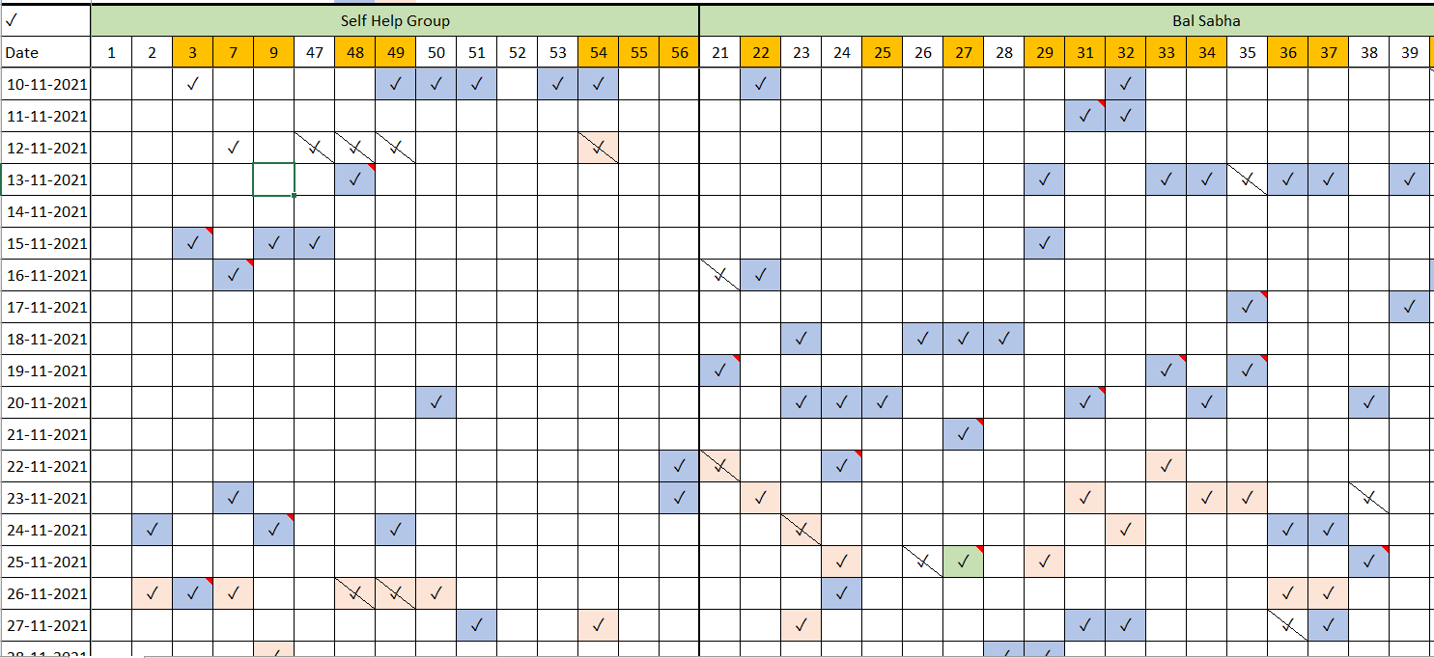
Trackers
Google Forms and Activity Tracker

Slide 15
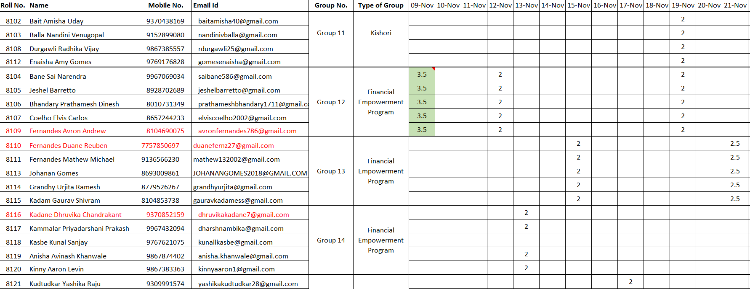
Trackers
Hours Tracker

